Slide 1
Texture Synthesis

Slide 2
Main Idea:
1) MRF method(local and stationary) for texture synthesis is a current ideal way.
2) “The size of neighborhood window” is the key parameter to quantify the quality.

Slide 3
Correlation Function
To quantitatively ascertain the distribution of distances between different phases.
Minkowski functionals:
A set of topological and geometrical descriptors of material microstructure.
Notes:
For a 2D set: area, contour length, Euler characteristic
Not all interesting features are motion invariant, convex continuous, so we need to extract more from these.

Slide 5
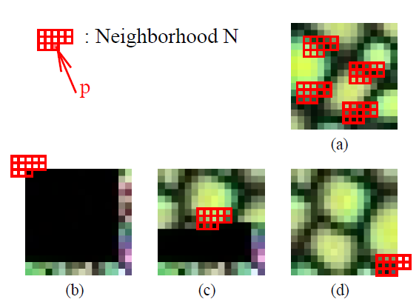
Single Resolution Synthesis
Notes:
(a) Is the input texture and (b)-(d) shows different synthesis stages of the output image. This is akin to putting together a jigsaw puzzle: the pieces are the individual pixels and the fitness between these pieces is determined by the colors of the surrounding neighborhood pixels.

Slide 6
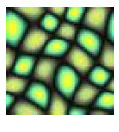
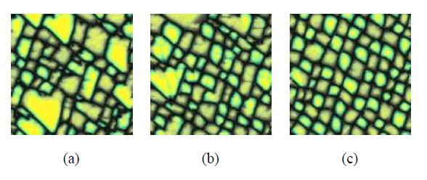
Synthesis results with different neighborhood sizes.
Notes:
Synthesis results with different neighborhood sizes. The neighborhood sizes are (a) 5*5 (b)7*7 (c)9*9. All images show are of size 128*128. Note that as the neighborhood size increases the resulting texture quality gets better. Of course the computation cost also increases.

Slide 7
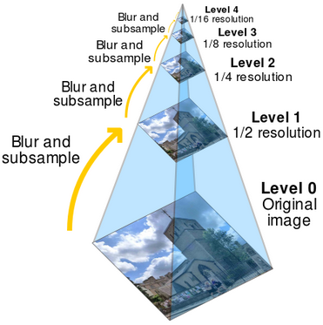
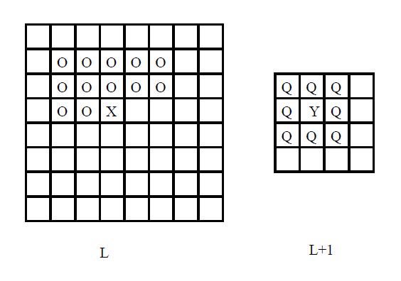
Multiresolution Synthesis Method
Notes:
When searching for a match for pixel X, the neighborhood vector is constructed that includes the O’s, Q’s, and Y, in scanline order.

Slide 8
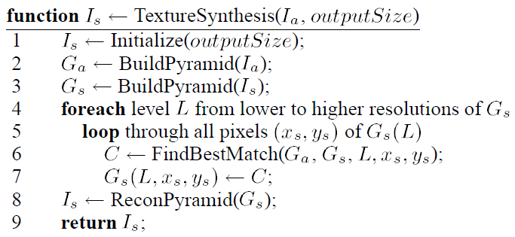
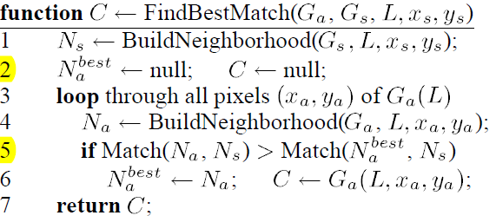
Summary of Algorithm Pseudocode

